Slide 1
Sentiment analysis on ‘DUMSOR’ Tweets
Mohammed-Hanif Abdulai

Slide 2
Sentiment analysis
Background
Role of Social Media
Getting Data
Tweet Analysis
Results

Slide 3
Background
Load Shedding for over a year
Got worse in 2015
From 24 ON/12 OFF TO 12 ON/24 OFF

Slide 4
Social media
Notes:
Ghanaians with internet access take to social media sites such as Twitter & Facebook usually to talk about and express their feelings about situations

Slide 5
Background
LOAD SHEDDING FOR OVER A YEAR
GOT WORSE THIS YEAR
FROM 24 ON/12 OFF TO 12 ON/24 OFF

Slide 6
QUestion
What are the feelings of Ghanaians on Twitter about the load shedding (Dumsor)?

Slide 7
Getting data from twitter
Prerequisites:
Twitter Account
A Twitter App

Slide 8
Getting data from twitter
Packages Installed:
twitteR
sentiment
plyr
ggplot2
wordcloud
RColorBrewer
RStem

Slide 9
Getting data from twitter
Obtain the following from your Twitter App:
1. api_key
2. api_secret
3. access_token
4. access_token_secret

Slide 10
GETTING DATA FROM TWITTER
Obtain the following from your Twitter App:
1. api_key
2. api_secret
3. access_token
4. access_token_secret

Slide 11
TWEET ANALYSIS
Request an n number of tweets from Twitter using keyword
(In this case ‘Dumsor’)

Slide 12
TWEET ANALYSIS (Cleaning Tweets)
Remove Retweets
Remove Mentions (@person)
Remove Punctuations
Remove Numbers
Remove html links
Remove spaces (white spaces, tabs etc.)
Convert all the tweets to lowercase

Slide 13
Naïve Bayes algorithm
P(outcome/evidence) = P(Likelihood of Evidence) x Prior prob of outcome
P(Evidence)

Slide 14
TWEET Sentiment ANALYSIS
Classify emotions using ‘Bayes algorithms’
Label tweets with unknown words ‘N/A’
Classify polarity; positive, neutral & negative
Create data frame using polarity & emotions
Plot
Notes:
In built emotions – 1500 words. Classified into anger, disgust, fear, joy, sadness and surprise
Conditional Probability in plain English: What is the probability that something will happen, given that something else has already happened.

Slide 15
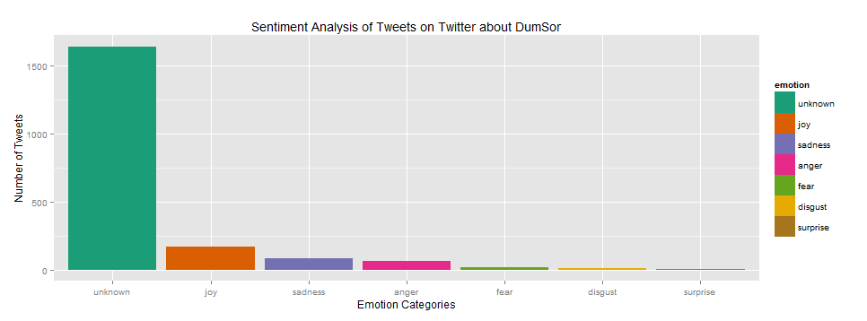
Notes:
In built emotions – 1500 words. Classified into anger, disgust, fear, joy, sadness and surprise

Slide 16
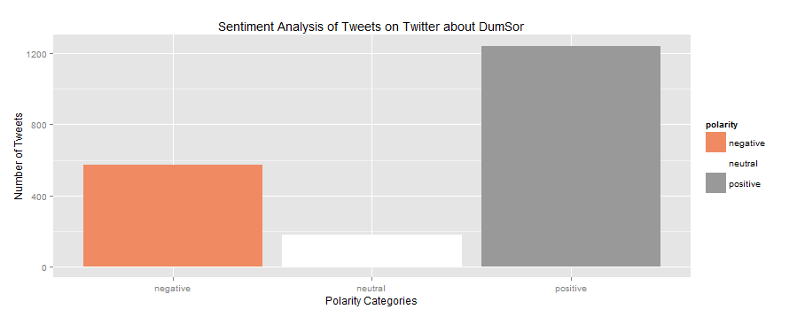
Notes:
In built emotions – 1500 words. Classified into anger, disgust, fear, joy, sadness and surprise

Slide 17
Notes:
In built emotions – 1500 words. Classified into anger, disgust, fear, joy, sadness and surprise
Anger 66
Disgust 10
Fear 18
sadness
87
surprise 8
joy 167
unknown 1641

Slide 18
Notes:
In built emotions – 1500 words. Classified into anger, disgust, fear, joy, sadness and surprise
Negative 429
Positive 1118
Neutral 94

Slide 19
APPARENT Results
Emotions (from known emotions):
Ghanaians were expressing ‘joy’ about ‘Dumsor’ on Twitter
Polarity
Ghanaians tweets about ‘Dumsor’ are positive
Notes:
In built emotions – 1500 words. Classified into anger, disgust, fear, joy, sadness and surprise

Slide 20
DISCERNED Results
Emotions (from known emotions):
Ghanaians had become apathetic about the Dumsor situation
Polarity
Ghanaians tweets about Dumsor were sarcastic.
Notes:
Since the sentiment analysis could not pick up sarcasm, it put them under the ‘positive’ polarity
Also factors such as

Slide 21
EXAMPLE TWEETS
“well in other news, because of dumsor a friend of mine is going to be a mommy soon tragic.” (joy, neutral)
“like flashlight a short animation film on dumsor by riddle delanyo sabblah” (joy, positive)
“my sec dumsor film has been selected for the accra short film competitionkindly vote by liking it” (joy, positive)
barclays bank introduces ‘dumsor’ loan (unknown, negative)
Notes:
Since the sentiment analysis could not pick up sarcasm, it put them under the ‘positive’ polarity
Also factors such as
competition
dance video

Slide 22
THANK YOU
Notes:
Since the sentiment analysis could not pick up sarcasm, it put them under the ‘positive’ polarity
Also factors such as

